Slide 1

Pedestrian Dynamics – Train Platform Simulation
Dominic Hänni, Patrick Manser and Stefan Zoller

Slide 2
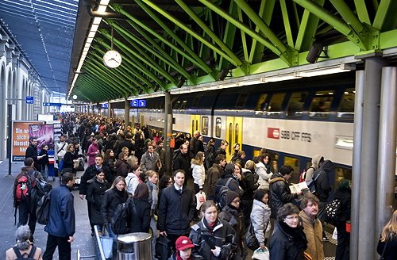
Introduction
Notes:
Motivation:
2 uf us travel from Winterthur to Zurich every day
-> experience pedestrian crowds on train platforms
->Questions:
Social force modell adaptable to train platform situations (e.g. real situations)?
Adjustments needed?
Optimal width of stair to minimize bottleneck situations?

Slide 3
Description of the Model
Agend based social force model
3 forces
Pedestrian interaction force
Wall force
Target force
Newtons law of motion
Euler time integration
Notes:
V_max!

Slide 4
Pedestrian interaction force
Notes:
Characteristics:
left: exponential -> pedestrians won’t touch
right: not isotropic, function of the angle between direction of movement (pedestrian a) and vector between a and b

Slide 5
Wall force
Notes:
exponential
Wall force range, wall force = force of the closest wall element

Slide 6
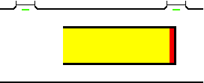
Target force

Slide 7
Stairs Decision Model

Slide 8
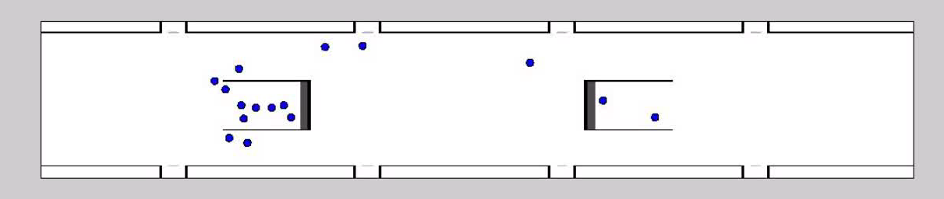

Slide 9
Improvements
Restrictions:
Only one change
First 10 time steps
Minimum value of pedestrians
Relative distance > 0.35

Slide 10
Spawn System
Conditions to spawn:
Maximum amount not reached yet
Square free of pedestrians
no fixed number of pedestrians per door

Slide 11
Width of Stair
Notes:
like to present some results
first part we asked us if there exists an optimal width of stair
created test configuration with 3 doors 1 stair (picture)
and ran the simulation for 5 different width of stair

Slide 12
Results Width of Stair
Notes:
Here you can see the simulation results
left side, mean simulation time
the simulation time is a well suitable parameter for the performance of the stairs and most important for train platform
Version 5 slowest
and versions 1-3 perform with nearly same time
version 4 is in between both, and for that not relevant
parameter on the right side is the mean pedestrian walking time.
leave platform as fast as possible
the result shows the same pattern as the simulation time so the to parameter are correlated

Slide 13
Width of Stair
Notes:
Here we see screenshots the different version after a running time of 20 seconds
bottom right corner version 5. big crow in front of the stairs compared to the others
left upper corner version 2. between stairs an train only 1 person. spawn problem
Spawn system, walk cross the spawn area, therefore only 1 pedest. Is spawnd at the time. Means more pedest. front dors, faster
bottom left corner version 3.
right upper corner version 1. more space -> due to security arriving trains

Slide 14
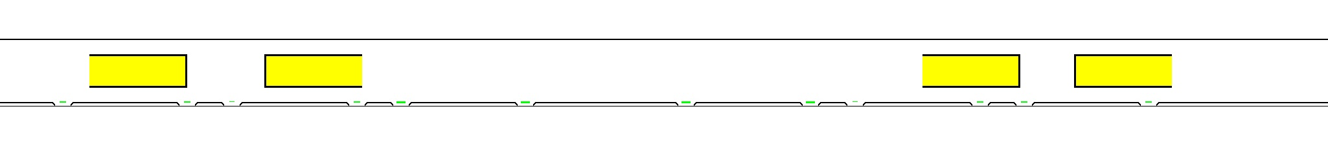
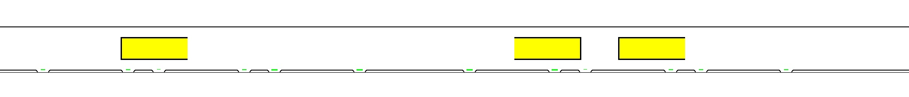
Realistic Simulations
Winterthur
Altstetten
Notes:
Applied the stairs on to realistic situations similar to: Winterthur 4 stairs, Altstetten 3 stairs.
We ran simulation with 600 pedestrians.

Slide 15
Results
Notes:
Pedestrians sit in trafic
increase the same until 30 seconds, then it decrease earlier in winti
the same we can see with the relative velocity. Achieve maximum velocity earlier
with 4 stairs, break up crow in front of the stairs faster,

Slide 16
Outlook
Possible improvements
Fixed number of pedestrians per door
Social factors, e.g. impatience
More random parameters
Pedestrians walking in the opposite direction
Notes:
Mentioned as the spawn problem
Include social factors, impatience of pedestrians, groups stay together, aggressive
more randomly distributed parameter like weight, aggressiveness
maybe boarding pedestrians
More simulations, focused on modeling and programming so we did not much simulations

Slide 17
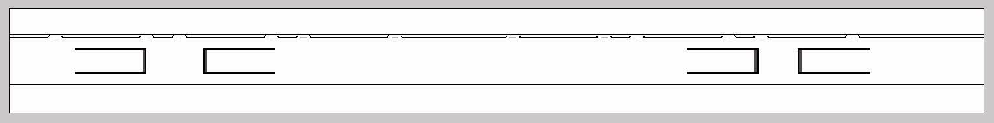

Slide 18
Questions?

